Slide 1
CS161 – Design and Architecture of Computer Systems
Week 2 - Discussion
*some slides adapted from:
Prof Daniel Wong UCR – EE/CS)

Slide 2
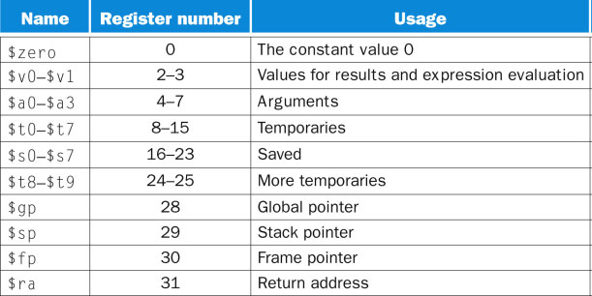
MIPS Registers
Register File
32 × 32-bit registers (0-31)
Assembly register names
32 Registers
…
R2
1 word
R1
R0
0
32 bits

Slide 3
Memory
Memory
4,294,967,295
(=2³² -1)
4-byte aligned:
each location is one byte
4 bytes (32 bits) = word
4 locations per instruction
4 Billion Memory Locations
…
3
1 word
2
1
0
8 bits (byte)

Slide 4
Memory and Register File
Memory
Register File
4,294,967,295
(=2³² -1)
R31
only load/store access memory
32-bit data called a “word”
4 bytes/instruction
4-byte aligned
4 Billion Memory Locations
32 Registers
…
3
1 word
…
2
R2
1 word
1
R1
0
R0
0
8 bits (byte)
32 bits (4 bytes)

Slide 5
Memory Operand Example
C code:
$s2 = h, $s3 = base address of array A
A[12] = h + A[8];
MIPS code:
index 8 → offset of 32
index 12 → offset of 48
lw $t0, 32($s3) # load word add $t0, $s2, $t0 sw $t0, 48($s3) # store word

Slide 6
MIPS Assembly Instructions

Slide 7
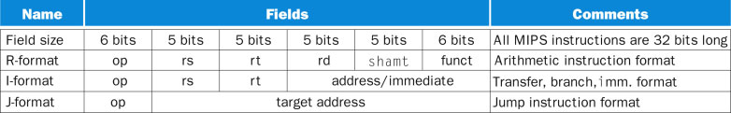
MIPS Instruction Format
op: operation code
rs: src register
rt: src register (R-type) / dst register (I-type)
rd: dst register
shamt: shift amount (shift left logical – sll amount)
funct: function code (extends opcode)
Notes:
Quickly.

Slide 8
R-format Example: add
op
rs
rt
rd
shamt
funct
6 bits
5 bits
5 bits
5 bits
5 bits
6 bits
add $r8, $r17, $r18 (add rd, rs, rt)
special
$r17
$r18
$r8
0
add

Slide 9
R-format Example: sll
op
rs
rt
rd
shamt
funct
6 bits
5 bits
5 bits
5 bits
5 bits
6 bits
sll $r8, $r17, 2 (sll rd, rs, shamt)
special
$r17
0
$r8
2
sll
shamt: shift amount (# positions to shift)
Shift Left Logical (sll)
sll by i bits multiplies by 2 x i
i.e., above 2 x 2 =4

Slide 10
sll Example
C code:
$s0 = i, $s1 = j, $s2 = base address of array A
j = A[i];
MIPS code:
index i → offset of i x 4
sll $t0, $s0, 2 # $t0 = i x 4 add $t0, $t0, $s2 # $t0 = &A[i] lw $s1, 0($t0) # $s1 = A[i]

Slide 11
MIPS I-format Instructions
op
rs
rt
immediate or offset
6 bits
5 bits
5 bits
16 bits
Immediate arithmetic and load/store instructions
rt: destination or source register number
Constant: –2¹⁵ to + (2¹⁵ – 1), used as immediate
Address: offset added to base address in rs

Slide 12
I-format Example: load
op
rs
rt
immediate or offset
6 bits
5 bits
5 bits
16 bits
lw $r8, 8($r17), $r8 ⬅ Mem[8+$r17]
lw
$r17
$r8
8
rs: src register
rt: dst register

Slide 13
I-format Example: store
op
rs
rt
immediate or offset
6 bits
5 bits
5 bits
16 bits
sw $r8, 8($r17), Mem[8+$r17] ⬅ $r8
sw
$r17
$r8
8
rs: src register
rt: src register

Slide 14
I-format Example: addi
op
rs
rt
immediate or offset
6 bits
5 bits
5 bits
16 bits
addi $r8,$r17, 8 $r8 ⬅ 8+$r17
addi
$r17
$r8
8

Slide 15
I-format Example: beq
op
rs
rt
offset
6 bits
5 bits
5 bits
16 bits
beq $r8,$r17, 8 if ($r8==$r17) PC ⬅ PC+4 + 8x4
beq
$r17
$r8
8
Most branch targets near branch
PC-relative addressing
Target address = PC + offset x 4
(PC already incremented by 4 by this time)

Slide 16
If Statements (branches)
C code:
$s0 = f, $s1 = g, $s2 = h, $s3 = i, $s4 = j
if (i==j)
f = g+h; else
f = g-h;
MIPS code:
bne $s3, $s4, Else add $s0, $s1, $s2 j Exit Else: sub $s0, $s1, $s2 Exit: …

Slide 17
More Conditional Operations
slt rd, rs, rt
if (rs < rt) rd = 1; else rd = 0;
slti rt, rs, constant
if (rs < constant) rt = 1; else rt = 0;
Use in combination with beq, bne
slt $t0, $s1, $s2 # if ($s1 < $s2) bne $t0, $zero, L # branch to L
L

Slide 18
NOT Operations
Useful to invert bits in a word
Change 0 to 1, and 1 to 0
MIPS has NOR 3-operand instruction
a NOR b == NOT ( a OR b )
nor $t0, $t1, $zero
Register 0: always read as zero
$zero
0000 0000 0000 0000 0000 0000 0000 0000
$t1
0000 0000 0000 0000 0011 1100 0000 0000
$t0
1111 1111 1111 1111 1100 0011 1111 1111
Notes:
nor $s1, $s2, $s3 $s1 = ~ ($s2 | $s3) Three reg. operands; bit-by-bit NOR
So if you make $s3 all zeros, then it is the traditional NOT instruction for (NOT $s2)

Slide 19
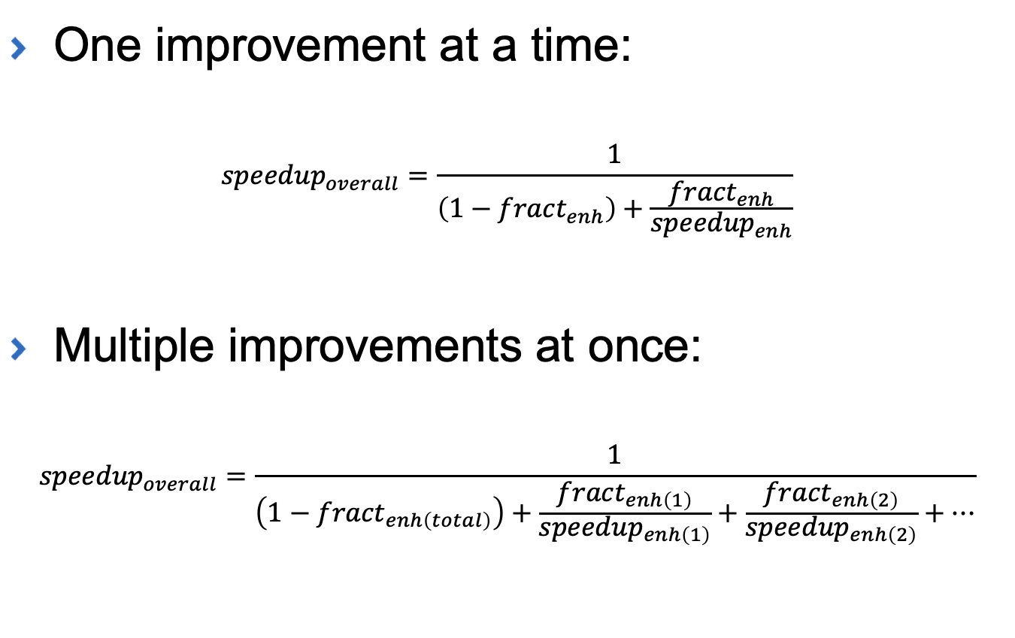
Amdahl’s Law
One improvement at a time:
$${speedup}_{overall}=\frac{1}{\left(1−{fract}_{enh}\right)+\frac{{fract}_{enh}}{{speedup}_{enh}}}$$
Multiple improvements at once:
$${speedup}_{overall}=\frac{1}{\left(1−{fract}_{enh\left(total\right)}\right)+\frac{{fract}_{enh\left(1\right)}}{{speedup}_{enh\left(1\right)}}+\frac{{fract}_{enh\left(2\right)}}{{speedup}_{enh\left(2\right)}}+⋯}$$

Slide 20
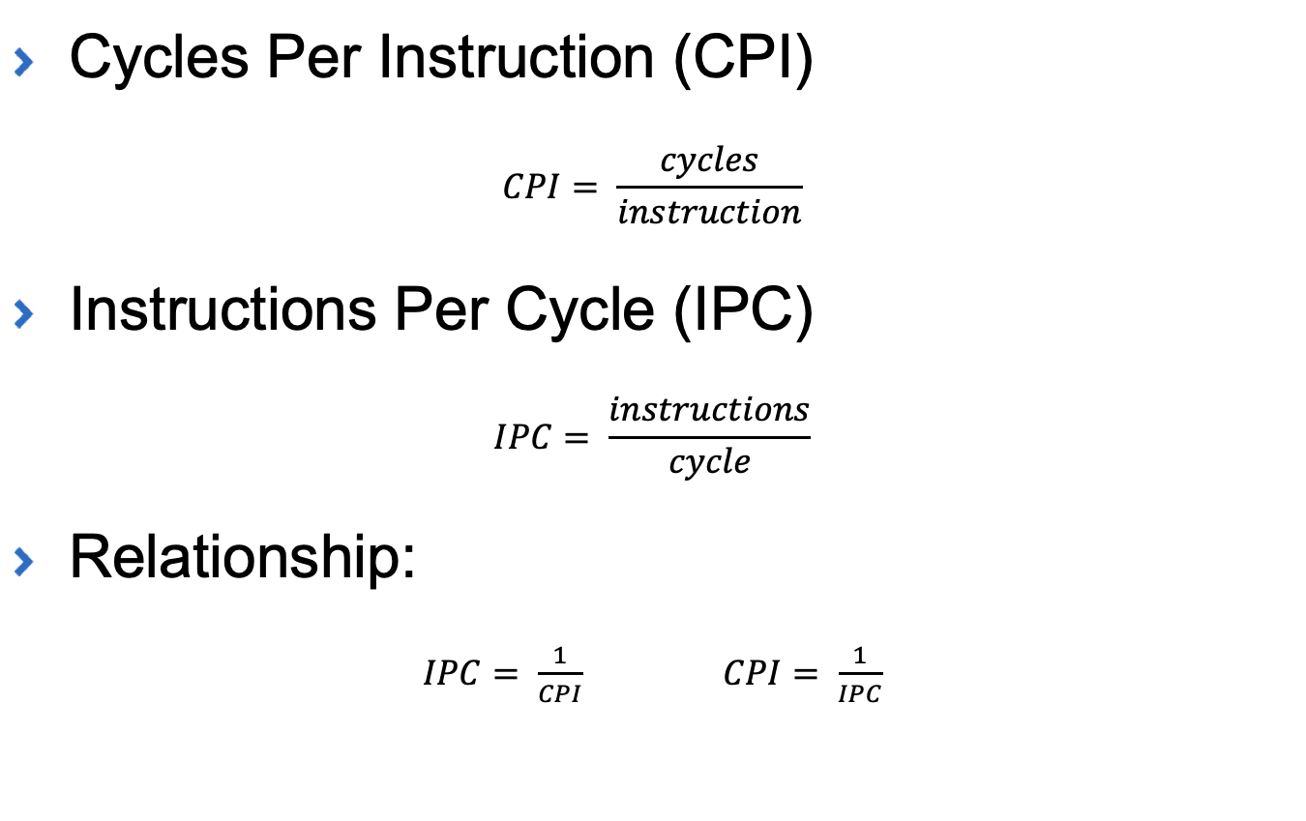
Instructions Per Cycle (IPC)
Cycles Per Instruction (CPI)
$$CPI= \frac{cycles}{instruction}$$
Instructions Per Cycle (IPC)
$$IPC= \frac{instructions}{cycle}$$
Relationship:
$IPC= \frac{1}{CPI}$ $CPI= \frac{1}{IPC}$

Slide 21
Practice Problems
Convert the following C code to MIPS assembly. Assume ‘i’ is held in $s0 and ‘j’ is held in $s1
if (i > j) {
j++;
}
else if (i == j ) {
i++;
}
else {
i = j+i
}
2) Convert the following MIPS assembly
to C code, where $s0, $s1, and $s2 are
variables i, j, and k, respectively and
$s3 is a pointer to an array A (i.e., the
base address of array A)
sll $t0, $s0, 2
add $t0, $t0, $s3
lw $s1, 0($t0)
addi $s0, $s0, 1
sll $t0, $s0, 2
add $t0, $t0, $s3
lw $s2, 0($t0)
add $t0, $s1, $s2
sw $t0, 12($s3)

Slide 22
CS161 – Design and Architecture of Computer Systems
CHP 3

Slide 23
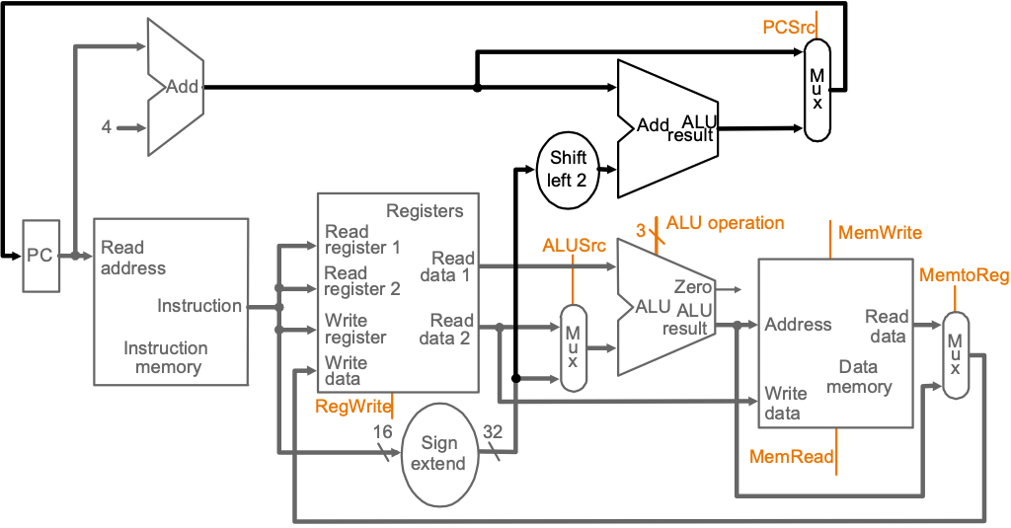
Datapath

Slide 24
Datapath
Register File
D-Memory/Cache
I-Memory/Cache

Slide 25
Instruction Flow
IF - Instruction fetch
ID - Instruction decode and register operand fetch
EX - Execute/Evaluate memory address
MEM - Memory operand fetch
WB - Store/writeback result
IF
ID
EX
MEM
WB

Slide 26
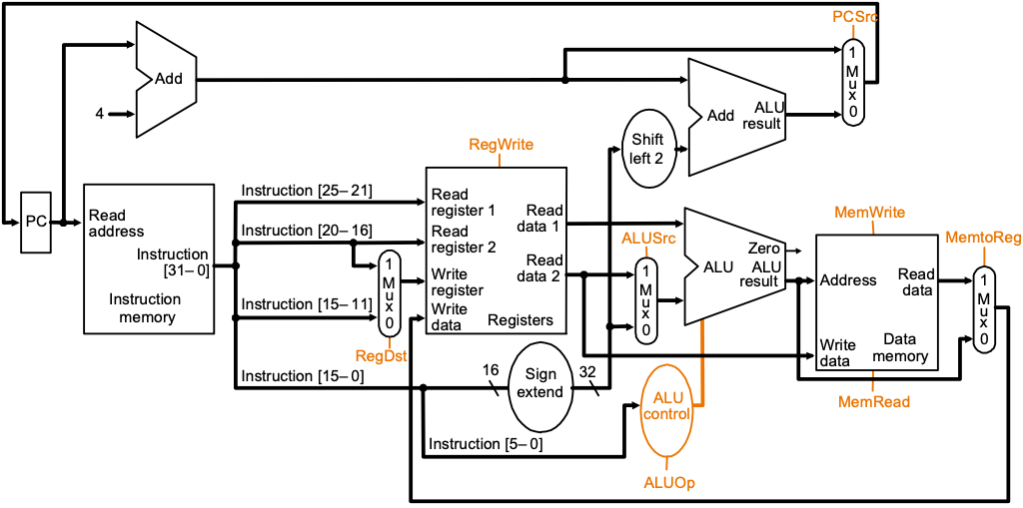
R-type Instructions – ADD Instruction
rs
rt
rd
ALU-Type
(ADD R3, R2, R1)
IF
ID/RF
EX
WB to Reg.
if MEM[PC] == ADD rd rs rt
GPR[rd] ← GPR[rs] + GPR[rt]
PC ← PC + 4
0
6-bit
rs
5-bit
rt
5-bit
rd
5-bit
0
5-bit
ADD
6-bit
ADD rd, rs, rt

Slide 27
I-type Instructions - ADDI Instruction
rs
rt
rd
ALU-Type
(ADD R3, R2, R1)
IF
ID/RF
EX
WB to Reg.
if MEM[PC] == ADDI rt rs immediate
GPR[rt] ← GPR[rs] + sign-extend (imm)
PC ← PC + 4
ADDI
6-bit
rs
5-bit
rt
5-bit
immediate
16-bit
ADDI rt, rs, immediate

Slide 28
I-type Instructions - LW Instruction
rs
rt
rd
LW
(LW R2, 4(R1))
IF
ID/RF
EX
MEM
WB to Reg.
if MEM[PC]==LW rt offset₁₆ (base)
Addr = sign-extend(offset) + GPR[base]
GPR[rt] ← MEM[Addr]
PC ← PC + 4
LW
6-bit
rs
5-bit
rt
5-bit
offset
16-bit
LW rt, offset(rs)

Slide 29
I-type Instructions - SW Instruction
rs
rt
rd
SW
(SW R2, 8(R1))
IF
ID/RF
EX
MEM
if MEM[PC]==SW rt offset₁₆ (base)
Addr = sign-extend(offset) + GPR[base]
MEM[Addr] ← GPR[rt]
PC ← PC + 4
SW
6-bit
rs
5-bit
rt
5-bit
offset
16-bit
SW rt, offset(rs)

Slide 30
I-type Instructions - Branch Instructions
rs
rt
rd
BEQ
(BEQ R3, R1, displace)
IF
ID/RF
EX(compare)
Potentially Update PC = PC+disp
if MEM[PC]==BEQ rs rt immediate₁₆
target = PC + 4 + sign-extend(immediate) x 4
if (GPR[rs]==GPR[rt]) PC ← target
else PC ← PC + 4
BEQ
6-bit
rs
5-bit
rt
5-bit
immediate
16-bit
BEQ rs, rt, immediate

Slide 31
J-type Instructions - Jump Instructions
J
(J displace)
IF
ID/RF
Update PC = PC+disp+00
if MEM[PC]==J immediate₂₆
target = { PC[31:28], immediate₂₆, 2’b00 }
PC ← target
J
6-bit
immediate
26-bit
J immediate

Slide 32
Single Cycle Implementation
Calculate cycle time assuming negligible delays except:
memory (2ns), ALU and adders (2ns), register file access (1ns)

Slide 33
Instruction Flow
Calculate cycle time assuming negligible delays except:
memory (2ns), ALU and adders (2ns), register file access (1ns)
IF
ID
EX
MEM
WB

Slide 34
Single Cycle – How long is the cycle?
Inst. Type | Inst. Mem. | Reg. File (read) | ALU (s) | Data Mem. | Reg. File (write) | Total
R-type | 2 | 1 | 2 | 0 | 1 | 6 ns
Load | 2 | 1 | 2 | 2 | 1 | 8 ns
Store | 2 | 1 | 2 | 2 | 0 | 7 ns
Branch | 2 | 1 | 2 | 0 | 0 | 5 ns
Jump | 2 | 0 | 0 | 0 | 0 | 2 ns
Inst. %
44
24
12
18
2
The cycle time must accommodate the longest operation: lw.
Cycle time = 8 ns but the CPI = 1.
If we can accommodate variable number of cycles for each instruction and a cycle time of 1ns.
CPI = 6*44% + 8*24% + 7*12% + 5*18% + 2*2% = 6.3

Slide 35
Control Signals

